Slide 1
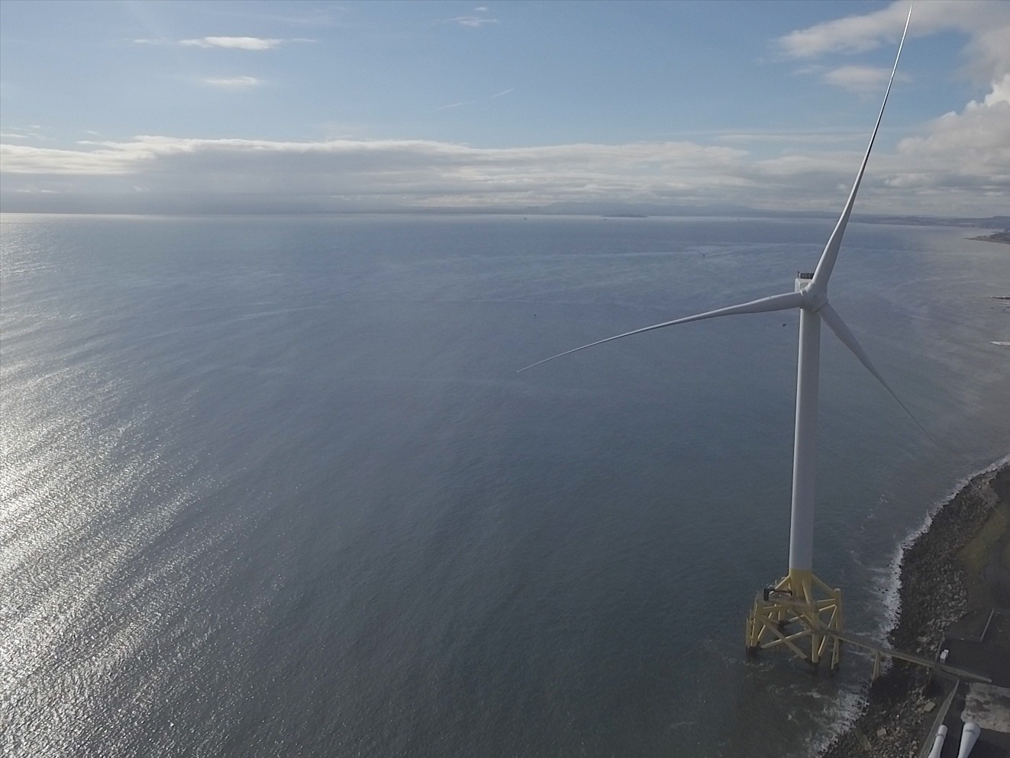

PCWG Welcome and introduction
13th December 2016

Slide 2
Housekeeping
Morning coffee booked for 11:00
Lunch booked for 13:00
Please see me during break for parking

Slide 3
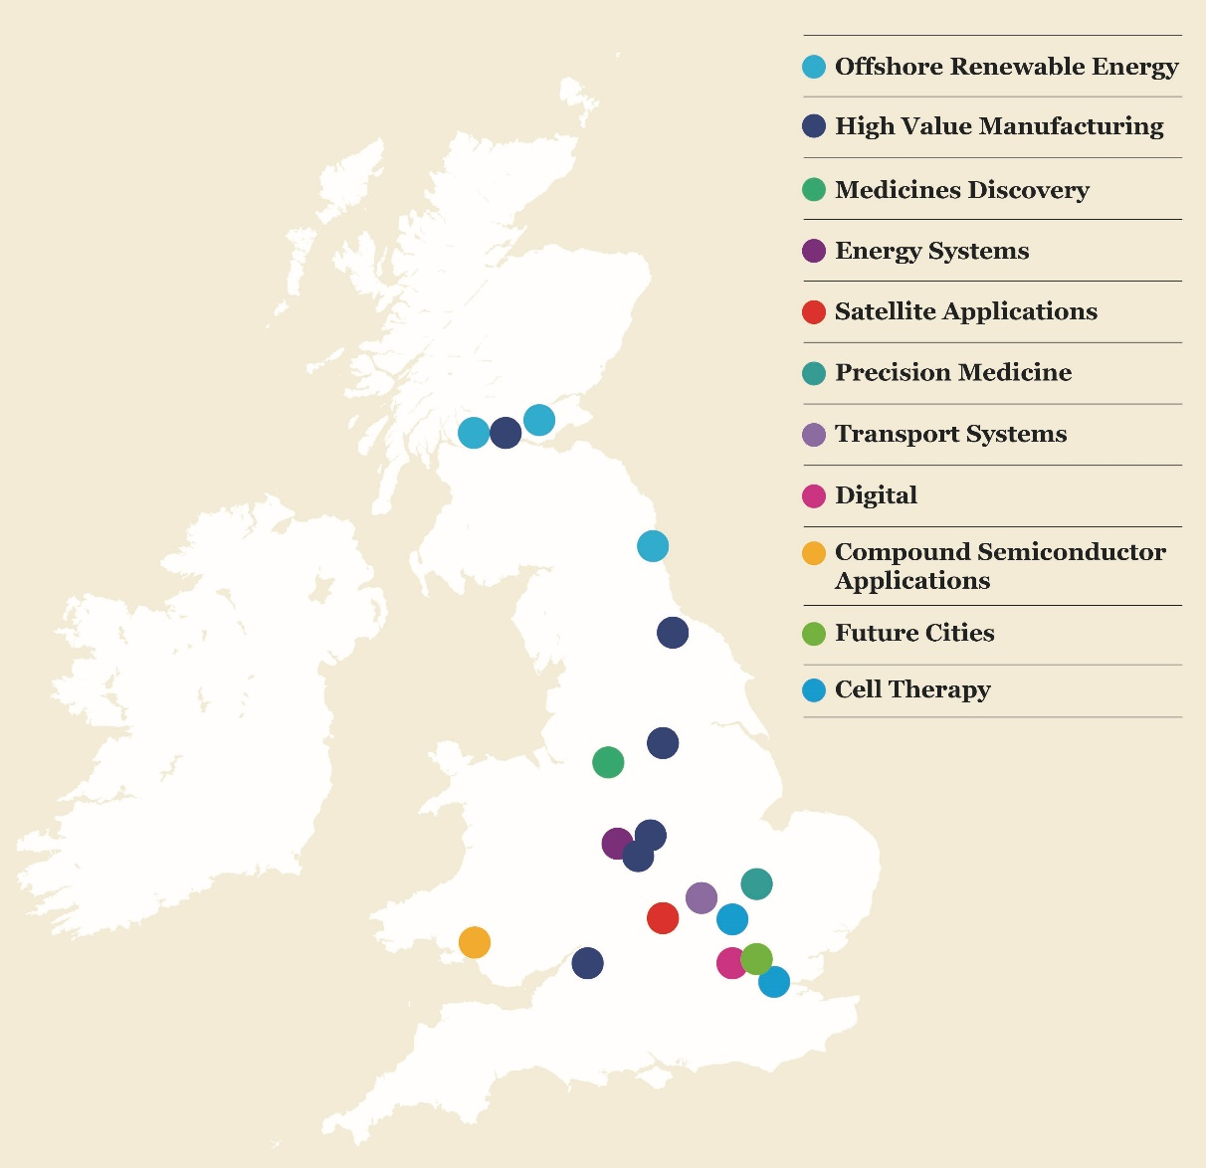

The Catapult Network A long-term vision for innovation & growth
11
Catapults
Established by InnovateUK
Designed to transform the UK's capability for innovation
Core grant leveraged with industry and other public funding

Slide 4
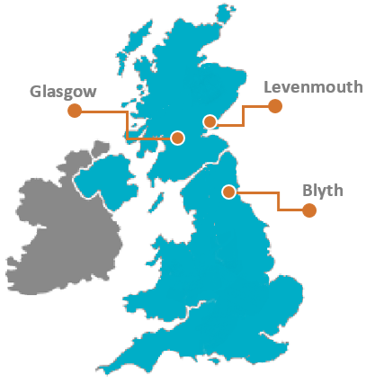
ORE Catapult
Our Vision: Abundant, affordable energy from offshore wind, wave and tide
Reduce the cost of offshore renewable energy
Deliver UK economic benefit
Engineering and research experts with deep sector knowledge
Independent and trusted partner
Work with industry and academia to commercialise new technologies
80+
technical experts

Slide 5
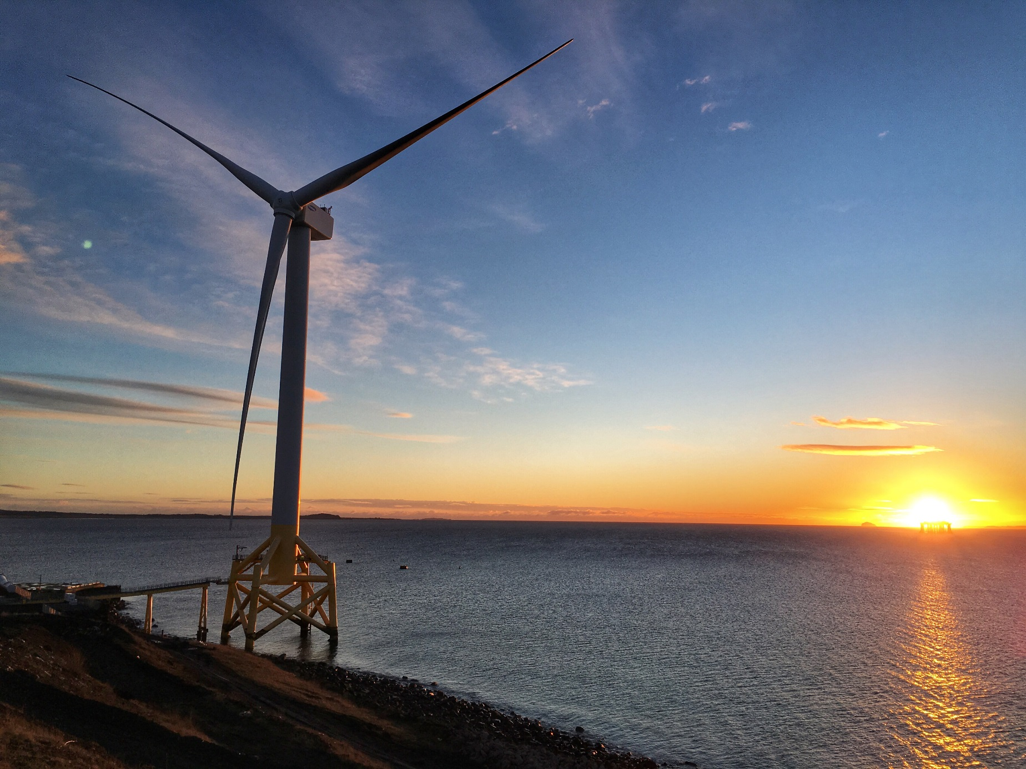
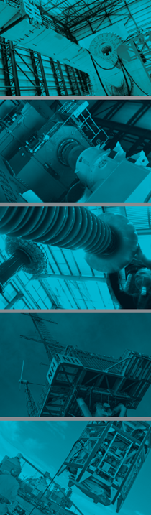
Our Testing & Demonstration Facilities
We operate the largest concentration of multi-purpose offshore renewable energy technology test and demonstration facilities in the world.

Slide 6
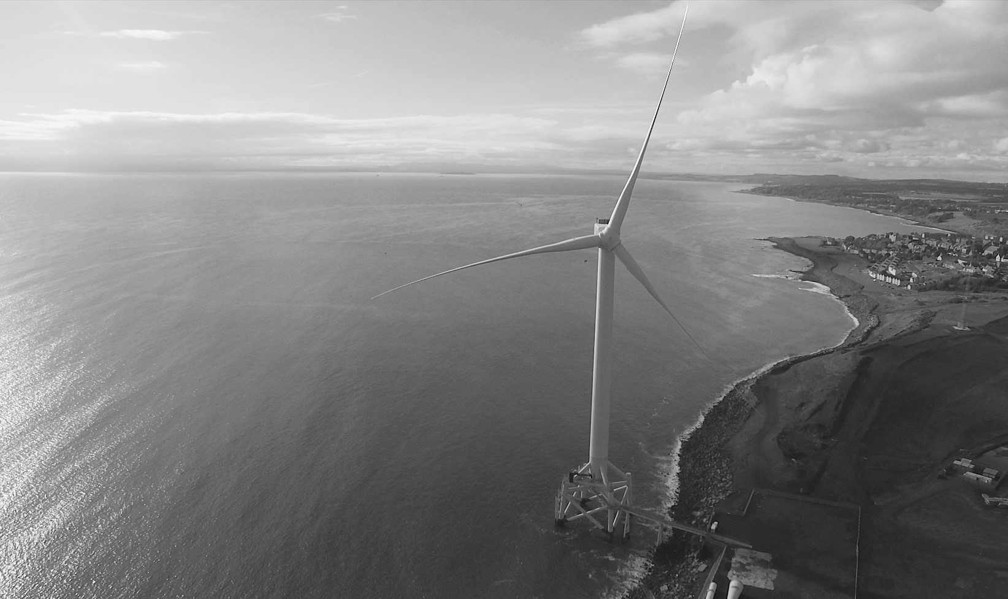
7MW Levenmouth Demonstration Turbine
The world’s most advanced open access offshore wind turbine dedicated to research and product validation

Slide 7

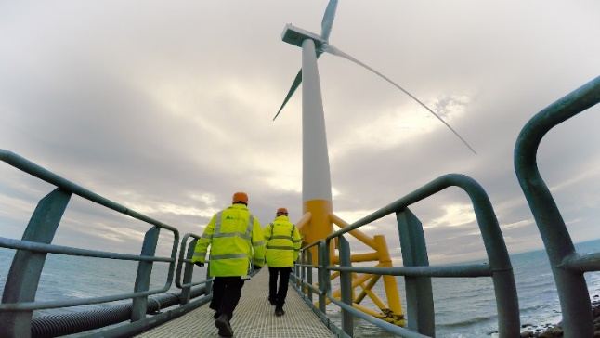
Recent announcements of note
Call for Wind & Ocean Conditions Scientific Chair
Deadline for entry: Wednesday 11th January 2017.
wosc.calls@ore.catapult.org.uk
More details online
Offshore Wind Sensors Technology Demonstration Opportunity Workshop
Fife (Levenmouth) on 12th January 2017 10:00 – 14:00
Register interest online
https://www.eventbrite.co.uk/e/offshore-wind-sensors-technology-demonstration-opportunity-tickets-29331619664

Slide 8
Welcome Thank you PCWG for asking us to host
13th December 2016

